Slide 1
Training of RNN
Lecture 6
Part 2
Generative AI for Computer Vision

Slide 2
Content
Training of RNN – Backpropagation through Time
Character Level Modelling through RNN (An example)
Deep RNN Models

Slide 3


































Backpropagation Through Time (BPTT)
Backpropagation Through Time (BPTT) is the training algorithm used for Recurrent Neural Networks (RNNs), where the network is unfolded across multiple time steps to form a deep computational graph.
During the forward pass, the hidden state is updated sequentially using the current input and the previous hidden state, allowing the network to capture temporal dependencies.
In the backward pass, the error is propagated from the final time step back through each preceding time step using the chain rule.
O
$$O_{1}$$
$$O_{2}$$
$$O_{3}$$
$$O_{4}$$
$$W_{o}$$
$$W_{o}$$
$$W_{o}$$
$$W_{o}$$
$$W_{o}$$
$$S$$
Unroll
$$h_{0}$$
$$h_{1}$$
$$h_{2}$$
$$h_{3}$$
$$h_{4}$$
$$W_{h}$$
$$S_{1}$$
$$S_{2}$$
$$S_{3}$$
$$S_{4}$$
$$W_{h}$$
$$W_{h}$$
$$W_{h}$$
$$W_{h}$$
$$W_{x}$$
$$W_{x}$$
$$W_{x}$$
$$W_{x}$$
$$W_{x}$$
$$x$$
$$x_{1}$$
$$x_{2}$$
$$x_{3}$$
$$x_{4}$$

Slide 4
Backpropagation Through Time (BPTT)
Since the same weights are shared across all time steps, the gradients computed at each step are accumulated before updating the parameters using gradient descent or its variants.
BPTT enables RNNs to learn patterns in sequential data such as text, speech, and time-series signals.
Example: RNN having 4 nodes (T=4) with shared weights.
O
$$O_{1}$$
$$O_{2}$$
$$O_{3}$$
$$O_{4}$$
$$W_{o}$$
$$W_{o}$$
$$W_{o}$$
$$W_{o}$$
$$W_{o}$$
$$S$$
Unroll
$$h_{0}$$
$$h_{1}$$
$$h_{2}$$
$$h_{3}$$
$$h_{4}$$
$$W_{h}$$
$$S_{1}$$
$$S_{2}$$
$$S_{3}$$
$$S_{4}$$
$$W_{h}$$
$$W_{h}$$
$$W_{h}$$
$$W_{h}$$
$$W_{x}$$
$$W_{x}$$
$$W_{x}$$
$$W_{x}$$
$$W_{x}$$
$$x$$
$$x_{1}$$
$$x_{2}$$
$$x_{3}$$
$$x_{4}$$

Slide 5





























How to train a RNN?
Backpropagation Through Time (BPTT)
Consider an RNN with four recurrent nodes, shared weights, a Softmax output layer, and a Cross-Entropy loss function.
$$O_{1}$$
$$O_{2}$$
$$O_{3}$$
$$O_{4}$$
$$W_{o}$$
$$W_{o}$$
$$W_{o}$$
$$W_{o}$$
$$h_{0}$$
$$h_{1}$$
$$h_{2}$$
$$h_{3}$$
$$h_{4}$$
$$S_{1}$$
$$S_{2}$$
$$S_{3}$$
$$S_{4}$$
$$W_{h}$$
$$W_{h}$$
$$W_{h}$$
$$W_{h}$$
$$W_{x}$$
$$W_{x}$$
$$W_{x}$$
$$W_{x}$$
$$x_{1}$$
$$x_{2}$$
$$x_{3}$$
$$x_{4}$$

Slide 6


















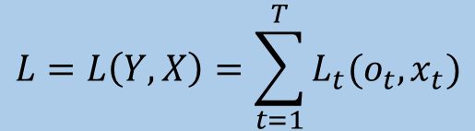
















How to train a RNN?
Backpropagation Through Time (BPTT)
Consider an RNN with four recurrent nodes, shared weights, a Softmax output layer, and a Cross-Entropy loss function.
$$L=L_{1}+L_{2}+L_{3}+L_{4}$$
$$L_{t}\left(o_{t},x_{t}\right)=−x_{t}\log\left(o_{t}\right)−\left(1−x_{t}\right)log⁡(1−o_{t})$$
$$L=L\left(Y,X\right)=\sum_{t=1}^{T}{L_{t}(o_{t},x_{t})}$$
$$O_{1}$$
$$L_{1}$$
$$O_{2}$$
$$L_{2}$$
$$O_{3}$$
$$L_{3}$$
$$O_{4}$$
$$L_{4}$$
$$W_{o}$$
$$W_{o}$$
$$W_{o}$$
$$W_{o}$$
$$h_{0}$$
$$h_{1}$$
$$h_{2}$$
$$h_{3}$$
$$h_{4}$$
$$S_{1}$$
$$S_{2}$$
$$S_{3}$$
$$S_{4}$$
$$W_{h}$$
$$W_{h}$$
$$W_{h}$$
$$W_{h}$$
$$W_{x}$$
$$W_{x}$$
$$W_{x}$$
$$W_{x}$$
$$x_{1}$$
$$x_{2}$$
$$x_{3}$$
$$x_{4}$$

Slide 7























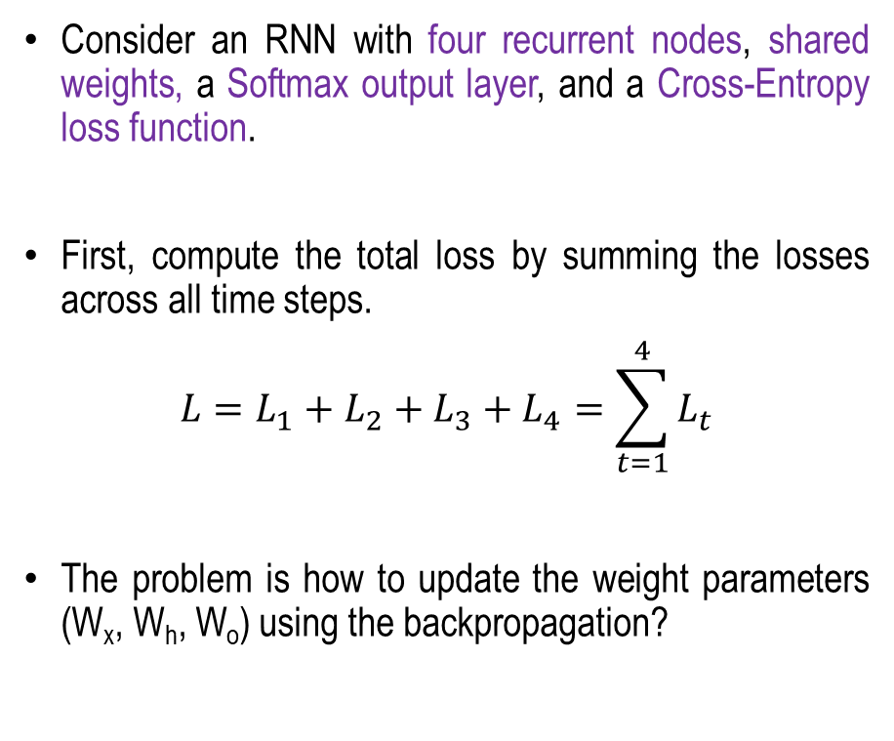











How to train a RNN?
Backpropagation Through Time (BPTT)
Consider an RNN with four recurrent nodes, shared weights, a Softmax output layer, and a Cross-Entropy loss function.
First, compute the total loss by summing the losses across all time steps.
$$L=L_{1}+L_{2}+L_{3}+L_{4}=\sum_{t=1}^{4}{L_{t}}$$
The problem is how to update the weight parameters (W_{x}, W_{h}, W_{o}) using the backpropagation?
$$L=L_{1}+L_{2}+L_{3}+L_{4}$$
$$O_{1}$$
$$L_{1}$$
$$O_{2}$$
$$L_{2}$$
$$O_{3}$$
$$L_{3}$$
$$O_{4}$$
$$L_{4}$$
$$W_{o}$$
$$W_{o}$$
$$W_{o}$$
$$W_{o}$$
$$h_{0}$$
$$h_{1}$$
$$h_{2}$$
$$h_{3}$$
$$h_{4}$$
$$S_{1}$$
$$S_{2}$$
$$S_{3}$$
$$S_{4}$$
$$W_{h}$$
$$W_{h}$$
$$W_{h}$$
$$W_{h}$$
$$W_{x}$$
$$W_{x}$$
$$W_{x}$$
$$W_{x}$$
$$x_{1}$$
$$x_{2}$$
$$x_{3}$$
$$x_{4}$$

Slide 8



































How to train a RNN?
Backpropagation Through Time (BPTT)
For backpropagation, it is required to compute the error gradients with respect to weight parameters ($Wx, Wh, Wo$).
$$L=L_{1}+L_{2}+L_{3}+L_{4}$$
$$O_{1}$$
$$L_{1}$$
$$O_{2}$$
$$L_{2}$$
$$O_{3}$$
$$L_{3}$$
$$O_{4}$$
$$L_{4}$$
$$W_{o}$$
$$W_{o}$$
$$W_{o}$$
$$W_{o}$$
$$h_{0}$$
$$h_{1}$$
$$h_{2}$$
$$h_{3}$$
$$h_{4}$$
$$S_{1}$$
$$S_{2}$$
$$S_{3}$$
$$S_{4}$$
$$W_{h}$$
$$W_{h}$$
$$W_{h}$$
$$W_{h}$$
$$W_{x}$$
$$W_{x}$$
$$W_{x}$$
$$W_{x}$$
$$x_{1}$$
$$x_{2}$$
$$x_{3}$$
$$x_{4}$$

Slide 9




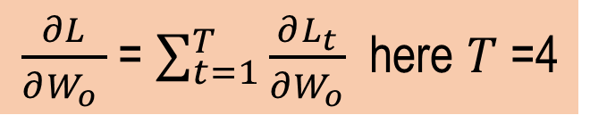





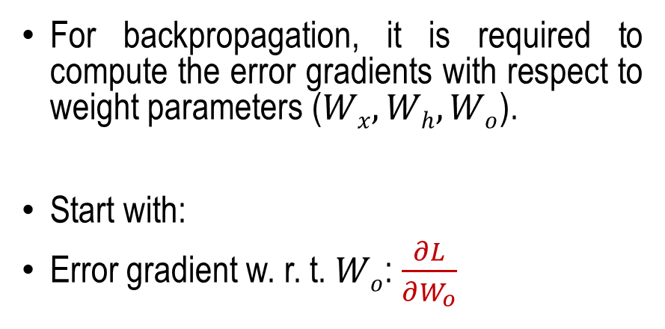

















How to train a RNN?
Backpropagation Through Time (BPTT)
For backpropagation, it is required to compute the error gradients with respect to weight parameters ($Wx, Wh, Wo$).
Start with:
Error gradient w. r. t. $Wo$: $\frac{∂L}{∂W_{o}}$
$$L=L_{1}+L_{2}+L_{3}+L_{4}$$
$$O_{1}$$
$$L_{1}$$
$$O_{2}$$
$$L_{2}$$
$$O_{3}$$
$$L_{3}$$
$$O_{4}$$
$$L_{4}$$
$$W_{o}$$
$$W_{o}$$
$$W_{o}$$
$$W_{o}$$
$$h_{0}$$
$$h_{1}$$
$$h_{2}$$
$$h_{3}$$
$$h_{4}$$
$$S_{1}$$
$$S_{2}$$
$$S_{3}$$
$$S_{4}$$
$\frac{∂L}{∂W_{o} }$= $\sum_{t=1}^{T}{\frac{∂L_{t}}{∂W_{o}}}$ here $T$=4
$$x_{1}$$
$$x_{2}$$
$$x_{3}$$
$$x_{4}$$

Slide 10








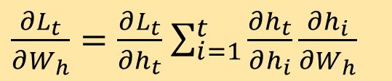











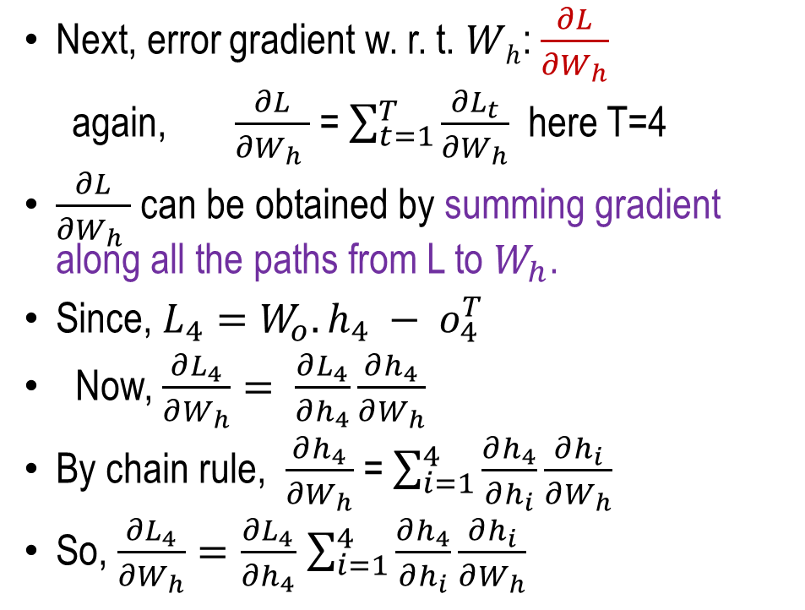








How to train a RNN?
Backpropagation Through Time (BPTT)
Next, error gradient w. r. t. $Wh$: $\frac{∂L}{∂W_{h}}$
again, $\frac{∂L}{∂W_{h} }$= $\sum_{t=1}^{T}{\frac{∂L_{t}}{∂W_{h}}}$ here T=4
$\frac{∂L}{∂W_{h} }$ can be obtained by summing gradient along all the paths from L to $W_{h}$.
Since, $L_{4}=W_{o}.h_{4} − o_{4}^{T}$
Now, $\frac{∂L_{4}}{∂W_{h}}= \frac{∂L_{4}}{∂h_{4}}\frac{∂h_{4}}{∂W_{h}}$
By chain rule, $\frac{∂h_{4}}{∂W_{h}}$= $\sum_{i=1}^{4}{\frac{∂h_{4}}{∂h_{i}}\frac{∂h_{i}}{∂W_{h}}}$
So, $\frac{∂L_{4}}{∂W_{h}}=\frac{∂L_{4}}{∂h_{4}}$ $\sum_{i=1}^{4}{\frac{∂h_{4}}{∂h_{i}}\frac{∂h_{i}}{∂W_{h}}}$
So, in generic form (t time instances)
$\frac{∂L_{t}}{∂W_{h}}=\frac{∂L_{t}}{∂h_{t}}$ $\sum_{i=1}^{t}{\frac{∂h_{t}}{∂h_{i}}\frac{∂h_{i}}{∂W_{h}}}$
$$L=L_{1}+L_{2}+L_{3}+L_{4}$$
$$O_{1}$$
$$L_{1}$$
$$O_{2}$$
$$L_{2}$$
$$O_{3}$$
$$L_{3}$$
$$O_{4}$$
$$L_{4}$$
$$h_{0}$$
$$h_{1}$$
$$h_{2}$$
$$h_{3}$$
$$h_{4}$$
$$S_{1}$$
$$S_{2}$$
$$S_{3}$$
$$S_{4}$$
$$W_{h}$$
$$W_{h}$$
$$W_{h}$$
$$W_{h}$$
$$W_{h}$$
$$x_{1}$$
$$x_{2}$$
$$x_{3}$$
$$x_{4}$$

Slide 11













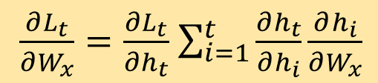














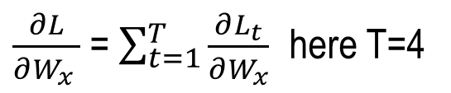
How to train a RNN?
Backpropagation Through Time (BPTT)
Finally, error gradient with respect to $W_{x}:\frac{∂L}{∂W_{x}}$
In similar to $\frac{∂L_{t}}{∂W_{h}}$, we can find
For all T instances
$$L=L_{1}+L_{2}+L_{3}+L_{4}$$
$\frac{∂L_{t}}{∂W_{x}}=\frac{∂L_{t}}{∂h_{t}}$ $\sum_{i=1}^{t}{\frac{∂h_{t}}{∂h_{i}}\frac{∂h_{i}}{∂W_{x}}}$
$$O_{1}$$
$$L_{1}$$
$$O_{2}$$
$$L_{2}$$
$$O_{3}$$
$$L_{3}$$
$$O_{4}$$
$$L_{4}$$
$$h_{0}$$
$$h_{1}$$
$$h_{2}$$
$$h_{3}$$
$$h_{4}$$
$$S_{1}$$
$$S_{2}$$
$$S_{3}$$
$$S_{4}$$
$\frac{∂L}{∂W_{x} }$= $\sum_{t=1}^{T}{\frac{∂L_{t}}{∂W_{x}}}$ here T=4
$$W_{x}$$
$$W_{x}$$
$$W_{x}$$
$$W_{x}$$
$$x_{1}$$
$$x_{2}$$
$$x_{3}$$
$$x_{4}$$

Slide 12











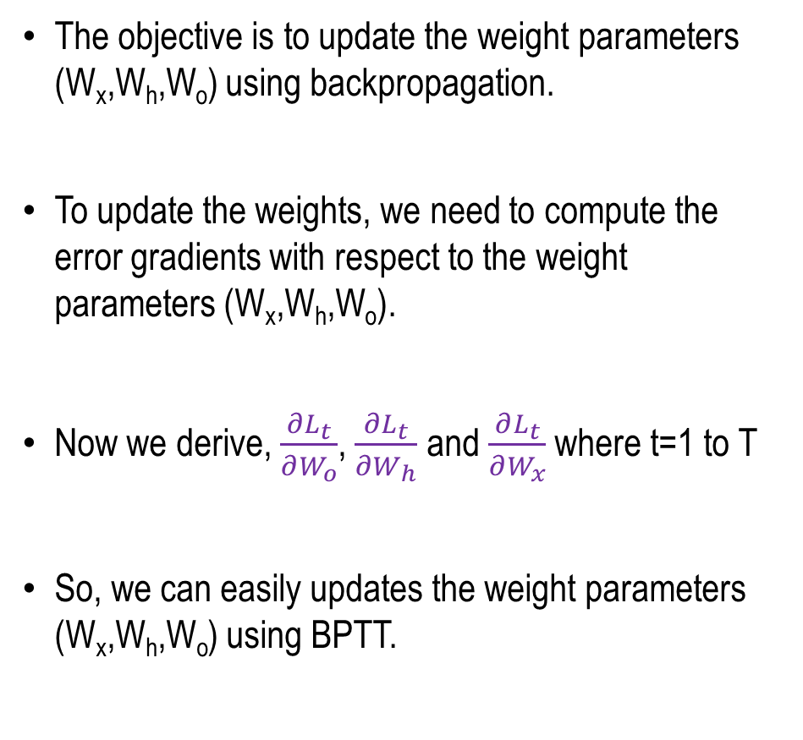























How to train a RNN?
Backpropagation Through Time (BPTT)
The objective is to update the weight parameters (W_{x},W_{h},W_{o}) using backpropagation.
To update the weights, we need to compute the error gradients with respect to the weight parameters (W_{x},W_{h},W_{o}).
Now we derive, $\frac{∂L_{t}}{∂W_{o}}$, $\frac{∂L_{t}}{∂W_{h}}$ and $\frac{∂L_{t}}{∂W_{x}}$ where t=1 to T
So, we can easily updates the weight parameters ($\text{W}\text{x}\text{,}\text{Wh}\text{,}\text{Wo}$) using BPTT.
$$L=L_{1}+L_{2}+L_{3}+L_{4}$$
$$O_{1}$$
$$L_{1}$$
$$O_{2}$$
$$L_{2}$$
$$O_{3}$$
$$L_{3}$$
$$O_{4}$$
$$L_{4}$$
$$W_{o}$$
$$W_{o}$$
$$W_{o}$$
$$W_{o}$$
$$h_{0}$$
$$h_{1}$$
$$h_{2}$$
$$h_{3}$$
$$h_{4}$$
$$S_{1}$$
$$S_{2}$$
$$S_{3}$$
$$S_{4}$$
$$W_{h}$$
$$W_{h}$$
$$W_{h}$$
$$W_{h}$$
$$W_{x}$$
$$W_{x}$$
$$W_{x}$$
$$W_{x}$$
$$x_{1}$$
$$x_{2}$$
$$x_{3}$$
$$x_{4}$$

Slide 13









































































































Backpropagation Through Time (BPTT)
Loss
$$O_{1}$$
$$O_{2}$$
$$O_{3}$$
$$O_{4}$$
$$O_{5}$$
$$O_{6}$$
$$O_{7}$$
$$O_{8}$$
$$O_{9}$$
$$O_{10}$$
$$O_{11}$$
$$O_{12}$$
$$O_{13}$$
$$O_{14}$$
$$O_{15}$$
$$W_{o}$$
$$W_{o}$$
$$W_{o}$$
$$W_{o}$$
$$W_{o}$$
$$W_{o}$$
$$W_{o}$$
$$W_{o}$$
$$W_{o}$$
$$W_{o}$$
$$W_{o}$$
$$W_{o}$$
$$W_{o}$$
$$W_{o}$$
$$W_{o}$$
$$h_{o}$$
$$h_{1}$$
$$h_{2}$$
$$h_{3}$$
$$h_{4}$$
$$h_{5}$$
$$h_{6}$$
$$h_{7}$$
$$h_{8}$$
$$h_{9}$$
$$h_{10}$$
$$h_{11}$$
$$h_{12}$$
$$h_{13}$$
$$h_{14}$$
$$S_{1}$$
$$S_{2}$$
$$S_{3}$$
$$S_{4}$$
$$S_{5}$$
$$S_{6}$$
$$S_{7}$$
$$S_{8}$$
$$S_{9}$$
$$S_{10}$$
$$S_{11}$$
$$S_{12}$$
$$S_{13}$$
$$S_{14}$$
$$S_{15}$$
$$W_{h}$$
$$W_{h}$$
$$W_{h}$$
$$W_{h}$$
$$W_{h}$$
$$W_{h}$$
$$W_{h}$$
$$W_{h}$$
$$W_{h}$$
$$W_{h}$$
$$W_{h}$$
$$W_{h}$$
$$W_{h}$$
$$W_{h}$$
$$W_{h}$$
$$W_{x}$$
$$W_{x}$$
$$W_{x}$$
$$W_{x}$$
$$W_{x}$$
$$W_{x}$$
$$W_{x}$$
$$W_{x}$$
$$W_{x}$$
$$W_{x}$$
$$W_{x}$$
$$W_{x}$$
$$W_{x}$$
$$W_{x}$$
$$W_{x}$$
$$x_{1}$$
$$x_{2}$$
$$x_{3}$$
$$x_{4}$$
$$x_{5}$$
$$x_{6}$$
$$x_{7}$$
$$x_{8}$$
$$x_{9}$$
$$x_{10}$$
$$x_{11}$$
$$x_{12}$$
$$x_{13}$$
$$x_{14}$$
$$x_{15}$$
Problem:
Vanishing Gradient
Can’t model the longer sentence properly
Concept taken from CS231n: Stanford Lecture by Fei Fei Li et. al.

Slide 14
































Truncated Backpropagation Through Time
Loss
Run forward and backward through chunks of the sequence instead of whole sequence.
$$O_{1}$$
$$O_{2}$$
$$O_{3}$$
$$O_{4}$$
$$O_{5}$$
$$W_{o}$$
$$W_{o}$$
$$W_{o}$$
$$W_{o}$$
$$W_{o}$$
$$h_{o}$$
$$S_{1}$$
$$h_{1}$$
$$S_{2}$$
$$h_{2}$$
$$S_{3}$$
$$h_{3}$$
$$S_{4}$$
$$h_{4}$$
$$S_{5}$$
$$W_{h}$$
$$W_{h}$$
$$W_{h}$$
$$W_{h}$$
$$W_{h}$$
$$W_{x}$$
$$W_{x}$$
$$W_{x}$$
$$W_{x}$$
$$W_{x}$$
$$x_{1}$$
$$x_{2}$$
$$x_{3}$$
$$x_{4}$$
$$x_{5}$$
Concept taken from CS231n: Stanford Lecture by Fei Fei Li et. al.

Slide 15






































































Truncated Backpropagation Through Time
Loss
Carry hidden states forward in time forever, but only backpropagate for some smaller number of steps.
$$O_{1}$$
$$O_{2}$$
$$O_{3}$$
$$O_{4}$$
$$O_{5}$$
$$O_{6}$$
$$O_{7}$$
$$O_{8}$$
$$O_{9}$$
$$O_{10}$$
$$W_{o}$$
$$W_{o}$$
$$W_{o}$$
$$W_{o}$$
$$W_{o}$$
$$W_{o}$$
$$W_{o}$$
$$W_{o}$$
$$W_{o}$$
$$W_{o}$$
$$h_{o}$$
$$S_{1}$$
$$h_{1}$$
$$S_{2}$$
$$h_{2}$$
$$S_{3}$$
$$h_{3}$$
$$S_{4}$$
$$h_{4}$$
$$S_{5}$$
$$h_{5}$$
$$S_{6}$$
$$h_{6}$$
$$S_{7}$$
$$h_{7}$$
$$S_{8}$$
$$h_{8}$$
$$S_{9}$$
$$h_{9}$$
$$S_{10}$$
$$W_{h}$$
$$W_{h}$$
$$W_{h}$$
$$W_{h}$$
$$W_{h}$$
$$W_{h}$$
$$W_{h}$$
$$W_{h}$$
$$W_{h}$$
$$W_{h}$$
$$W_{x}$$
$$W_{x}$$
$$W_{x}$$
$$W_{x}$$
$$W_{x}$$
$$W_{x}$$
$$W_{x}$$
$$W_{x}$$
$$W_{x}$$
$$W_{x}$$
$$x_{1}$$
$$x_{2}$$
$$x_{3}$$
$$x_{4}$$
$$x_{5}$$
$$x_{6}$$
$$x_{7}$$
$$x_{8}$$
$$x_{9}$$
$$x_{10}$$
Concept taken from CS231n: Stanford Lecture by Fei Fei Li et. al.

Slide 16

Truncated Backpropagation Through Time
Loss
$$O_{1}$$
$$O_{2}$$
$$O_{3}$$
$$O_{4}$$
$$O_{5}$$
$$O_{6}$$
$$O_{7}$$
$$O_{8}$$
$$O_{9}$$
$$O_{10}$$
$$O_{11}$$
$$O_{12}$$
$$O_{13}$$
$$O_{14}$$
$$O_{15}$$
$$W_{o}$$
$$W_{o}$$
$$W_{o}$$
$$W_{o}$$
$$W_{o}$$
$$W_{o}$$
$$W_{o}$$
$$W_{o}$$
$$W_{o}$$
$$W_{o}$$
$$W_{o}$$
$$W_{o}$$
$$W_{o}$$
$$W_{o}$$
$$W_{o}$$
$$h_{o}$$
$$h_{1}$$
$$h_{2}$$
$$h_{3}$$
$$h_{4}$$
$$h_{5}$$
$$h_{6}$$
$$h_{7}$$
$$h_{8}$$
$$h_{9}$$
$$h_{10}$$
$$h_{11}$$
$$h_{12}$$
$$h_{13}$$
$$h_{14}$$
$$S_{1}$$
$$S_{2}$$
$$S_{3}$$
$$S_{4}$$
$$S_{5}$$
$$S_{6}$$
$$S_{7}$$
$$S_{8}$$
$$S_{9}$$
$$S_{10}$$
$$S_{11}$$
$$S_{12}$$
$$S_{13}$$
$$S_{14}$$
$$S_{15}$$
$$W_{h}$$
$$W_{h}$$
$$W_{h}$$
$$W_{h}$$
$$W_{h}$$
$$W_{h}$$
$$W_{h}$$
$$W_{h}$$
$$W_{h}$$
$$W_{h}$$
$$W_{h}$$
$$W_{h}$$
$$W_{h}$$
$$W_{h}$$
$$W_{h}$$
$$W_{x}$$
$$W_{x}$$
$$W_{x}$$
$$W_{x}$$
$$W_{x}$$
$$W_{x}$$
$$W_{x}$$
$$W_{x}$$
$$W_{x}$$
$$W_{x}$$
$$W_{x}$$
$$W_{x}$$
$$W_{x}$$
$$W_{x}$$
$$W_{x}$$
$$x_{1}$$
$$x_{2}$$
$$x_{3}$$
$$x_{4}$$
$$x_{5}$$
$$x_{6}$$
$$x_{7}$$
$$x_{8}$$
$$x_{9}$$
$$x_{10}$$
$$x_{11}$$
$$x_{12}$$
$$x_{13}$$
$$x_{14}$$
$$x_{15}$$
Concept taken from CS231n: Stanford Lecture by Fei Fei Li et. al.

Slide 17







































Sequence to Sequence (Encoder Decoder Model)
Many to One (Encoder) One to Many (Decoder)
$$O_{1}$$
$$O_{2}$$
$$O_{3}$$
$$W_{o}$$
$$W_{o}$$
$$W_{o}$$
$$h_{o}$$
$$h_{1}$$
$$h_{2}$$
$$h_{3}$$
$$h_{T−1}$$
$$h_{1}$$
$$h_{2}$$
$$h_{3}$$
$$S_{1}$$
$$S_{2}$$
$$S_{3}$$
$$S_{T}$$
$$h_{T}$$
$$S_{1}$$
$$S_{2}$$
$$S_{3}$$
$$W_{E}$$
$$W_{E}$$
$$W_{E}$$
$$W_{E}$$
$$W_{E}$$
$$W_{D}$$
$$W_{D}$$
$$W_{D}$$
$$W_{D}$$
$$W_{x}$$
$$W_{x}$$
$$W_{x}$$
$$W_{x}$$
$$x_{1}$$
$$x_{2}$$
$$x_{3}$$
$$x_{T}$$
Encoder (Many to One)
Decoder (One to Many)
Concept taken from CS231n: Stanford Lecture by Fei Fei Li et. al.

Slide 18










RNN based Character Level Modelling
Training Phase:
Vocabulary: {e, a, g, r}
Character level embedding:
  e = [0 0 0 1]
  a = [0 0 1 0]
  g = [0 1 0 0]
  r= [1 0 0 0]
Example:
  Training sequence:
  [e a g e r]
$$h_{t}=tanh(W_{h}h_{t−1}+W_{x}x_{t})$$
$$y_{t}=W_{o}h_{t}$$
$$Y_{t}$$
$$W_{o}$$
$$h_{t−1}$$
$$h_{t}$$
$$S_{t}$$
$$W_{h}$$
$$W_{x}$$
$$x_{t}$$
At time step t
Concept taken from CS231n: Stanford Lecture by Fei Fei Li et. al.

Slide 19

RNN based Character Level Modelling
Training Phase:
Vocabulary: {e, a, g, r}
Character level embedding:
  e = [0 0 0 1]
  a = [0 0 1 0]
  g = [0 1 0 0]
  r= [1 0 0 0]
Example:
  Training sequence:
  [e a g e r]
“e”
“a”
“g”
“e”
Input Characters
0
0
0
1
0
0
10
0
100
0
0
0
1
Input Layer
$$h_{t}=tanh(W_{h}h_{t−1}+W_{x}x_{t})$$
Concept taken from CS231n: Stanford Lecture by Fei Fei Li et. al.

Slide 20








RNN based Character Level Modelling
Training Phase:
Vocabulary: {e, a, g, r}
Character level embedding:
  e = [0 0 0 1]
  a = [0 0 1 0]
  g = [0 1 0 0]
  r= [1 0 0 0]
Example:
  Training sequence:
  [e a g e r]
“e”
“a”
“g”
“e”
Input Characters
0
0
0
1
0
0
10
0
100
0
0
0
1
Input Layer
$$W_{x}$$
$$W_{x}$$
$$W_{x}$$
$$W_{x}$$
Hidden Layer
$$W_{h}$$
$$W_{h}$$
$$W_{h}$$
$$h_{t}=tanh(W_{h}h_{t−1}+W_{x}x_{t})$$
Concept taken from CS231n: Stanford Lecture by Fei Fei Li et. al.

Slide 21











RNN based Character Level Modelling
Training Phase:
“e”
“a”
“g”
“e”
Input Characters
Vocabulary: {e, a, g, r}
Character level embedding:
  e = [0 0 0 1]
  a = [0 0 1 0]
  g = [0 1 0 0]
  r= [1 0 0 0]
Example:
  Training sequence:
  [e a g e r]
0
0
0
1
0
0
10
0
100
0
0
0
1
Input Layer
$$W_{x}$$
$$W_{x}$$
$$W_{x}$$
$$W_{x}$$
Hidden Layer
$$W_{h}$$
$$W_{h}$$
$$W_{h}$$
$$W_{o}$$
$$W_{o}$$
$$W_{o}$$
$$W_{o}$$
0.7
0.3
2.5
1.1
0.8
-2
1.50.1
1.51.0
0.62.1
2.6
0.8
1.0
1.7
Output Layer
“a”
“g”
“e”
“r”
Target Output
Concept taken from CS231n: Stanford Lecture by Fei Fei Li et. al.

Slide 22
RNN based Character Level Modelling
Testing Phase:
“e”
Input Characters
0
0
0
1
Input Layer
Hidden Layer
0.7
0.3
2.5
1.1
Output Layer
.02
.03
.92
.03
Softmax Layer
“a”
Sample
Concept taken from CS231n: Stanford Lecture by Fei Fei Li et. al.

Slide 23
RNN based Character Level Modelling
Testing Phase:
“e”
“a”
Input Characters
0
0
0
1
0
0
10
Input Layer
Hidden Layer
0.7
0.3
2.5
1.1
Output Layer
.02
.03
.92
.03
Softmax Layer
“a”
Target Output
Concept taken from CS231n: Stanford Lecture by Fei Fei Li et. al.

Slide 24
RNN based Character Level Modelling
Testing Phase:
“e”
“a”
Input Characters
0
0
0
1
0
0
10
Input Layer
Hidden Layer
0.7
0.3
2.5
1.1
0.8
-2
1.50.1
Output Layer
.02
.03
.92
.03
.04
.91
.02
.03
Softmax Layer
“a”
“g”
Target Output
Concept taken from CS231n: Stanford Lecture by Fei Fei Li et. al.

Slide 25
RNN based Character Level Modelling
Testing Phase:
“e”
“a”
“g”
Input Characters
0
0
0
1
0
0
10
0
100
Input Layer
Hidden Layer
0.7
0.3
2.5
1.1
0.8
-2
1.50.1
Output Layer
.02
.03
.92
.03
.04
.91
.02
.03
Softmax Layer
“a”
“g”
Target Output
Concept taken from CS231n: Stanford Lecture by Fei Fei Li et. al.

Slide 26
RNN based Character Level Modelling
Testing Phase:
“e”
“a”
“g”
Input Characters
0
0
0
1
0
0
10
0
100
Input Layer
Hidden Layer
0.7
0.3
2.5
1.1
0.8
-2
1.50.1
1.5
1.0
0.6
2.1
Output Layer
.02
.03
.92
.03
.04
.91
.02
.03
.02.03
.01
.94
Softmax Layer
“a”
“g”
“e”
Target Output
Concept taken from CS231n: Stanford Lecture by Fei Fei Li et. al.

Slide 27
RNN based Character Level Modelling
Testing Phase:
“e”
“a”
“g”
“e”
Input Characters
0
0
0
1
0
0
10
0
100
0001
Input Layer
Hidden Layer
0.7
0.3
2.5
1.1
0.8
-2
1.50.1
1.5
1.0
0.6
2.1
2.6
0.8
1.0
1.7
Output Layer
.02
.03
.92
.03
.04
.91
.02
.03
.02.03
.01
.94
.93
.04
.01.02
Softmax Layer
“a”
“g”
“e”
“r”
Target Output
Concept taken from CS231n: Stanford Lecture by Fei Fei Li et. al.

Slide 28
RNN based Character Level Modelling
Testing Phase:
“e”
“a”
“g”
“e”
Input Characters
0
0
0
1
0
0
10
0
100
0001
Input Layer
Character embedding is performed using one-hot encoding.
However, different embedding methods can also be used.
Hidden Layer
0.7
0.3
2.5
1.1
0.8
-2
1.50.1
1.5
1.0
0.6
2.1
2.6
0.8
1.0
1.7
Output Layer
.02
.03
.92
.03
.04
.91
.02
.03
.02.03
.01
.94
.93
.04
.01.02
Softmax Layer
“a”
“g”
“e”
“r”
Target Output
Concept taken from CS231n: Stanford Lecture by Fei Fei Li et. al.

Slide 29
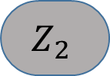

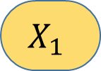
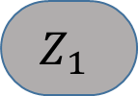
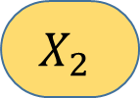
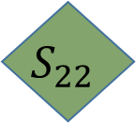
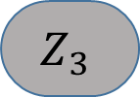
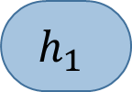
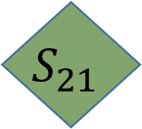
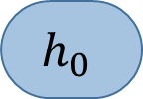
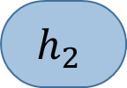

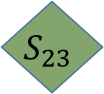
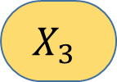

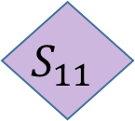
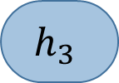






Deep RNN Models
$$Z_{1}$$
$$Z_{2}$$
$$Z_{3}$$
$$g_{0}$$
$$S_{21}$$
$$g_{1}$$
$$S_{22}$$
$$g_{2}$$
$$S_{23}$$
$$g_{3}$$
$$Y_{1}$$
$$Y_{2}$$
$$Y_{3}$$
$$h_{0}$$
$$S_{11}$$
$$h_{1}$$
$$S_{12}$$
$$h_{2}$$
$$S_{13}$$
$$h_{3}$$
$$X_{1}$$
$$X_{2}$$
$$X_{3}$$
Concept taken from CS231n: Stanford Lecture by Fei Fei Li et. al.

Slide 30
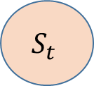

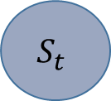
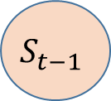

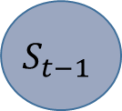




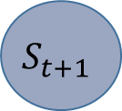
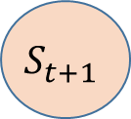

Bidirectional RNN
A Bidirectional RNN (BiRNN) is a recurrent neural network that processes a sequence in both the forward and backward directions, allowing it to use both past and future context at every time step.
This helps the model better understand the meaning of each element in the sequence.
Example: "He went to the bank to deposit money." The meaning of "bank" becomes clear from the following words ("to deposit money").
$$Y_{t−1}$$
$$Y_{t}$$
$$Y_{t−1}$$
$$S_{t−1}$$
$$h_{t−1}$$
$$S_{t}$$
$$h_{1}$$
$$S_{t+1}$$
Forward Pass
$$S_{t−1}$$
$$h_{t}$$
$$S_{t}$$
$$h_{t+1}$$
$$S_{t+1}$$
Backward Pass
Concept taken from CS231n: Stanford Lecture by Fei Fei Li et. al.

Slide 31
Summery
Training of RNN – Backpropagation through Time
Character Level Modelling through RNN (An example)
Deep RNN Models

Slide 32
LSTM
Next
Lecture 6: Part 3
Generative AI for Computer Vision

Slide 33




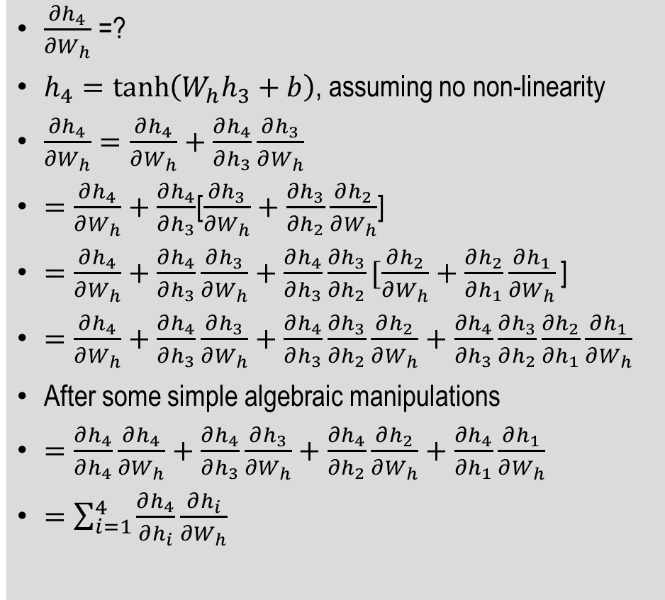





How to train a RNN?
Backpropagation Through Time (BPTT)
$\frac{∂h_{4}}{∂W_{h}}$=?
$h_{4}=\tanh\left(W_{h}h_{3}+b\right)$, assuming no non-linearity
$\frac{∂h_{4}}{∂W_{h}}=\frac{∂h_{4}}{∂W_{h}}+\frac{∂h_{4}}{∂h_{3}}\frac{∂h_{3}}{∂W_{h}}$
$=\frac{∂h_{4}}{∂W_{h}}+\frac{∂h_{4}}{∂h_{3}}$[$\frac{∂h_{3}}{∂W_{h}}+\frac{∂h_{3}}{∂h_{2}}\frac{∂h_{2}}{∂W_{h}}$]
$=\frac{∂h_{4}}{∂W_{h}}+\frac{∂h_{4}}{∂h_{3}}\frac{∂h_{3}}{∂W_{h}}+\frac{∂h_{4}}{∂h_{3}}\frac{∂h_{3}}{∂h_{2}}[\frac{∂h_{2}}{∂W_{h}}+\frac{∂h_{2}}{∂h_{1}}\frac{∂h_{1}}{∂W_{h}}\text{]}$
$=\frac{∂h_{4}}{∂W_{h}}+\frac{∂h_{4}}{∂h_{3}}\frac{∂h_{3}}{∂W_{h}}+\frac{∂h_{4}}{∂h_{3}}\frac{∂h_{3}}{∂h_{2}}\frac{∂h_{2}}{∂W_{h}}+\frac{∂h_{4}}{∂h_{3}}\frac{∂h_{3}}{∂h_{2}}\frac{∂h_{2}}{∂h_{1}}\frac{∂h_{1}}{∂W_{h}}$
After some simple algebraic manipulations
$=\frac{∂h_{4}}{∂h_{4}}\frac{∂h_{4}}{∂W_{h}}+\frac{∂h_{4}}{∂h_{3}}\frac{∂h_{3}}{∂W_{h}}+\frac{∂h_{4}}{∂h_{2}}\frac{∂h_{2}}{∂W_{h}}+\frac{∂h_{4}}{∂h_{1}}\frac{∂h_{1}}{∂W_{h}}$
$=\sum_{i=1}^{4}{\frac{∂h_{4}}{∂h_{i}}\frac{∂h_{i}}{∂W_{h}}}$
$$L=L_{1}+L_{2}+L_{3}+L_{4}$$
$$O_{1}$$
$$L_{1}$$
$$O_{2}$$
$$L_{2}$$
$$O_{3}$$
$$L_{3}$$
$$O_{4}$$
$$L_{4}$$
$$W_{o}$$
$$W_{o}$$
$$W_{o}$$
$$W_{o}$$
$$h_{0}$$
$$h_{1}$$
$$h_{2}$$
$$h_{3}$$
$$h_{4}$$
$$S_{1}$$
$$S_{2}$$
$$S_{3}$$
$$S_{4}$$
$$W_{h}$$
$$W_{h}$$
$$W_{h}$$
$$W_{h}$$
$$W_{x}$$
$$W_{x}$$
$$W_{x}$$
$$W_{x}$$
$$x_{1}$$
$$x_{2}$$
$$x_{3}$$
$$x_{4}$$

